Slide 1
Zuul
Adding a Gateway Server

Slide 2


Slide 3
Objective
By the end of this 45 minute session you will be able create a Zuul server and set up your Microservices to route requests through it.

Slide 4
Needs / Benefits
This is a large portion of the modern Microservices Framework
Centralized Logging
Propagate Authorization Tokens

Slide 5
Implementing Logging in Zuul
Environment Setup
Creating Eureka Server
Configure Feign to route requests through Zuul

Slide 6
Environment Setup

Slide 7
Git clone https://github.com/Cognizant-FSE/petclinic-zuul-starter
Create Owner, Pet, Vet, Visit databases
Run config-server
Run All 4 Microservices, starting with Owner
Run petclinic-rest-client to populate database
(If continuing from Eureka deck, continue to use current project. No changes necessary)

Slide 8
There is only Zuul

Slide 9
What does Zuul Do?
It is an API Gateway that can implement:
Centralized logging
Authentication, authorization and security
Service Aggregation
Fault tolerance
Analytics and debugging

Slide 10
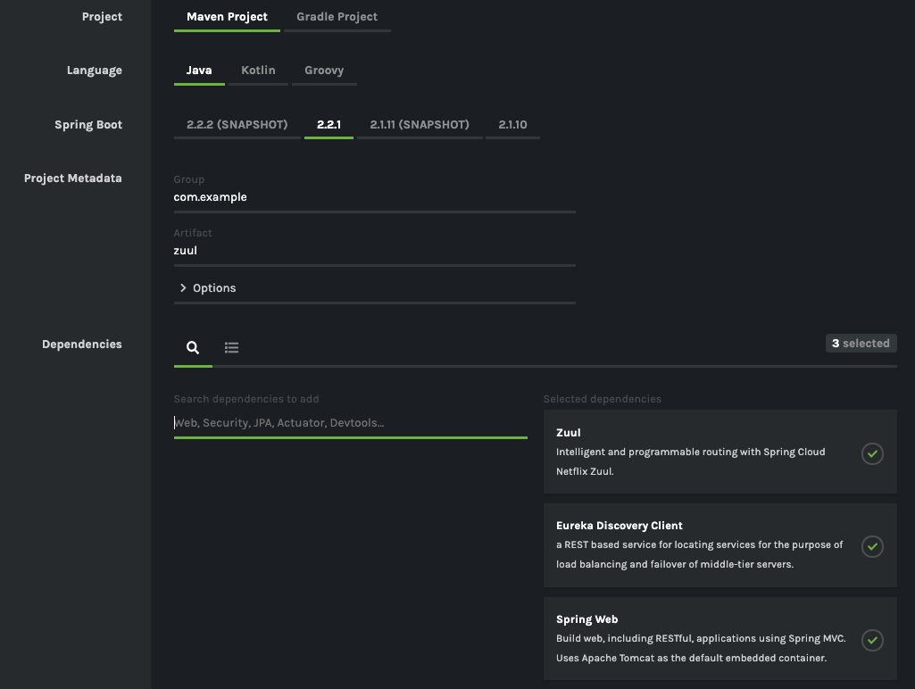
Create new Zuul Server
Zuul Server
Eureka Discovery
Spring Web

Slide 11
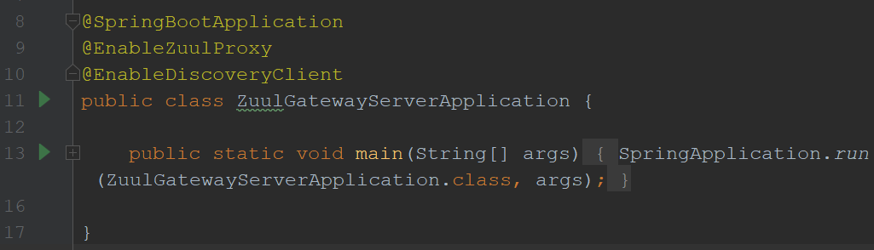
Enable Zuul Proxy
@EnableZuulProxy
@EnableDiscoveryClient
Notes:
Zuul should also register itself when it starts up. We want multiple instances of Zuul up, otherwise we create a bottleneck and undermine the whole purpose of microservices

Slide 12
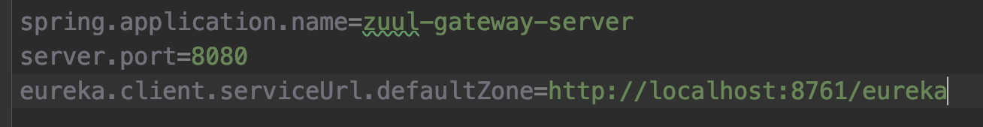
Configure settings in application.properties
Name, port and where to find eureka

Slide 13
Implement Logging in Zuul

Slide 14
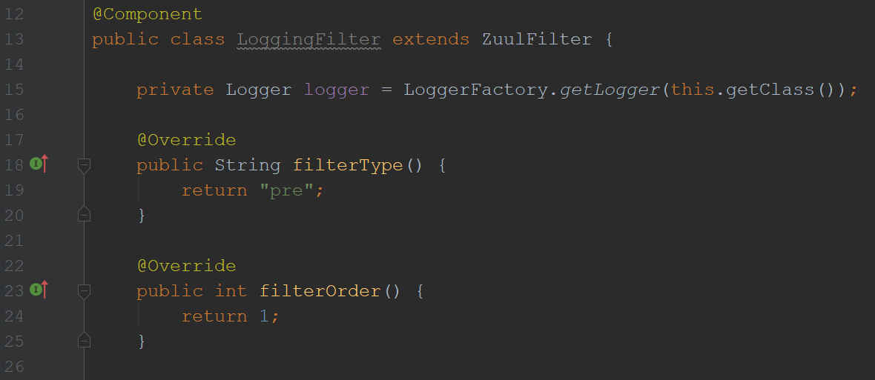
Implement Logging
Create @Component that extends ZuulFilter
There are 4 methods to Override
org.slf4j.Logger
When to filter? pre, post, error
Order it should be executed
(ZuulSecurityFilter, ZuulServletFilter, etc..)
Notes:
Create a new class in the zuul server called LoggingFilter.

Slide 15
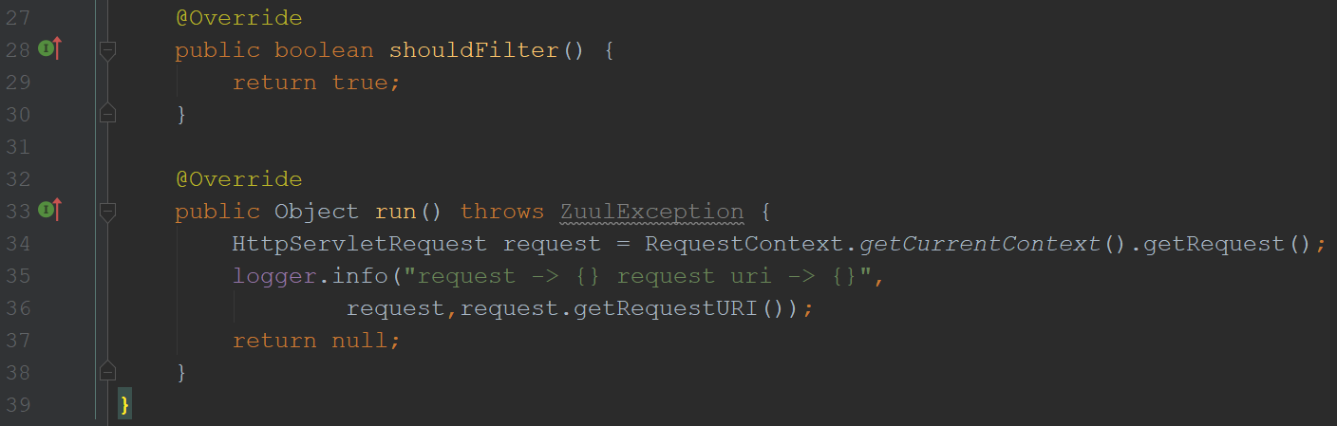
Implement Logging
Should it even filter to begin with?
Run method is where we implement the filtering
Notes:
Here we are just logging the request and the request uri so that we can see the zuul traffic and where it came from.

Slide 16
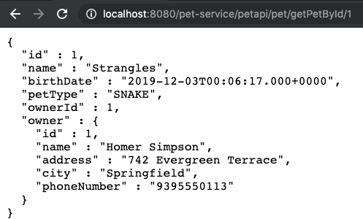
Manually Route Request Through Zuul
{Zuul url} / {app name} / {request to app}
Request passes through and is logged in zuul server

Slide 17
Route Feign through Zuul

Slide 18
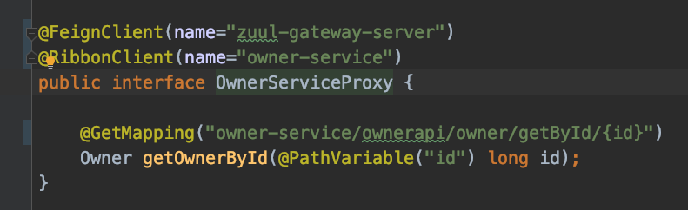
Automatically Route Requests Through Zuul
Change ALL @FeignClient annotations to access zuul
Append app name (where endpoint lives) to front of @GetMapping
OwnerServiceProxy is in petclinic-pet

Slide 19

Automatically Route Requests Through Zuul
Hit endpoint again
Both regular and Feign requests pass through zuul

Slide 20
Review
Environment Setup
Creating a Zuul Server
Implement Logging with Zuul
Configure Feign to route through Zuul

Slide 21
Objective
By the end of this 45 minute session you will be able create a Zuul server and set up your Microservices to route requests through it.

Slide 22
How do you create a Zuul server?
What are benefits of Zuul?

Slide 24
Jason Monroe
688776

